Slide 1


Fatal Police Shootings in the U.S.
DSC 630 Predictive Analytics
Final Project
Presented By: Blandon Lee

Slide 2
The Current Problem
Issue:
Police involved shootings are a highly sensitive subject and a point of emphasis for many people around the country. With the increase in media outlets and their coverage of such incidents the people want answers and solutions.
Data:
The data was gathers by The Washington Post beginning in 2015. This data was collected from Kaggle and is open to the public.
This dataset will be utilized for the purpose of examining how race impacts fatal police shootings.
Statement:
I plan to use race, gender, and mental illness to help better understand and predict fatal police shootings.

Slide 3
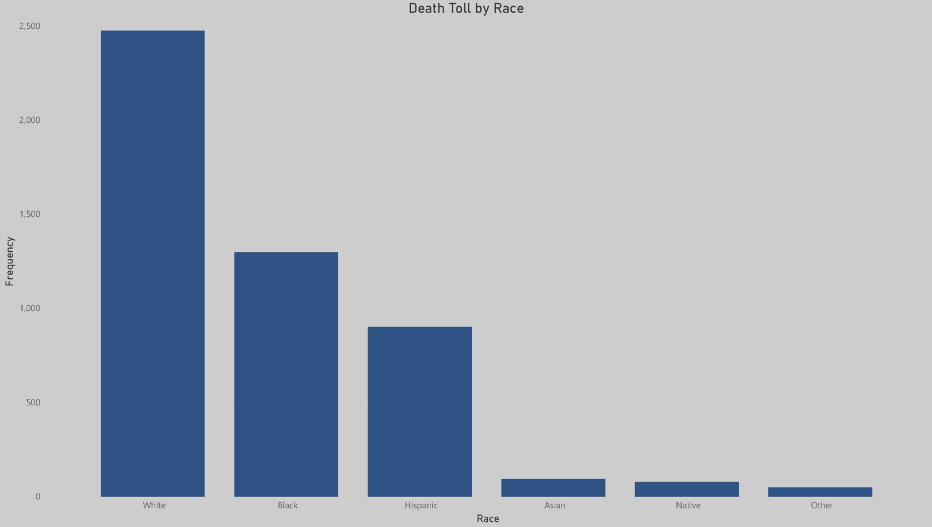
Fatal Shootings by Race

Slide 4
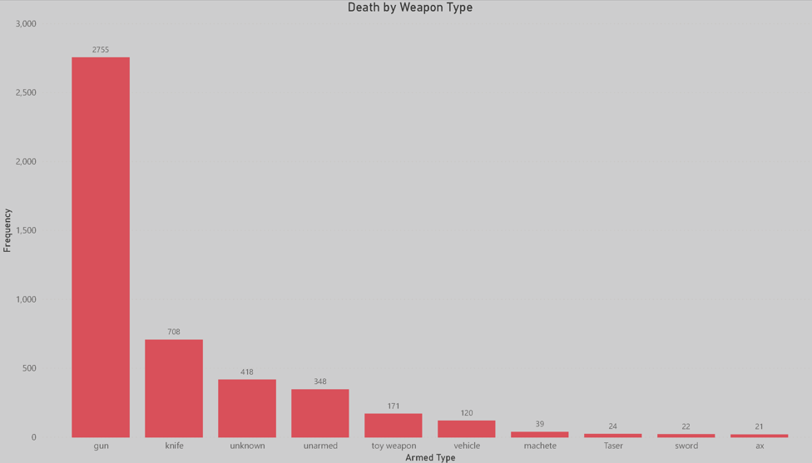
Top Weapons Used

Slide 5
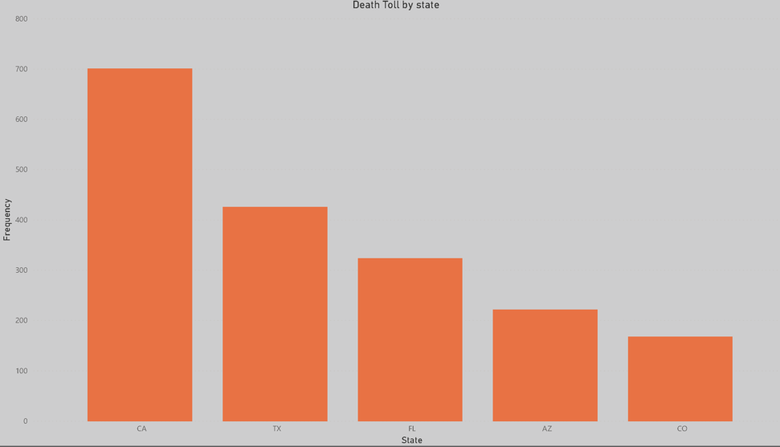
Top States for Fatal Shootings

Slide 6
Model Approaches
There where several approaches used to examine the topic. Each method provided different but relevant insights that helped to build a broader picture of the issue and its causes.

Slide 7
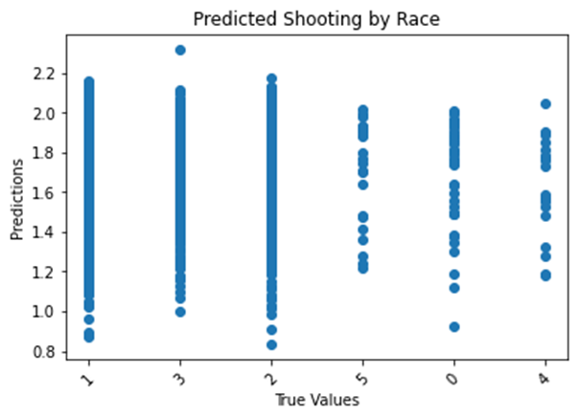
Model 1 Linear Regression

Slide 8
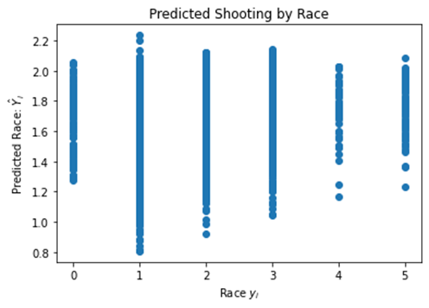
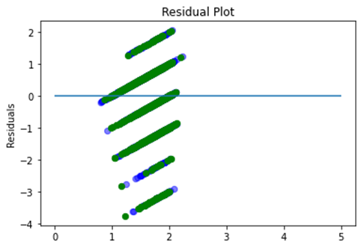
Model 2 Linear Regression

Slide 9
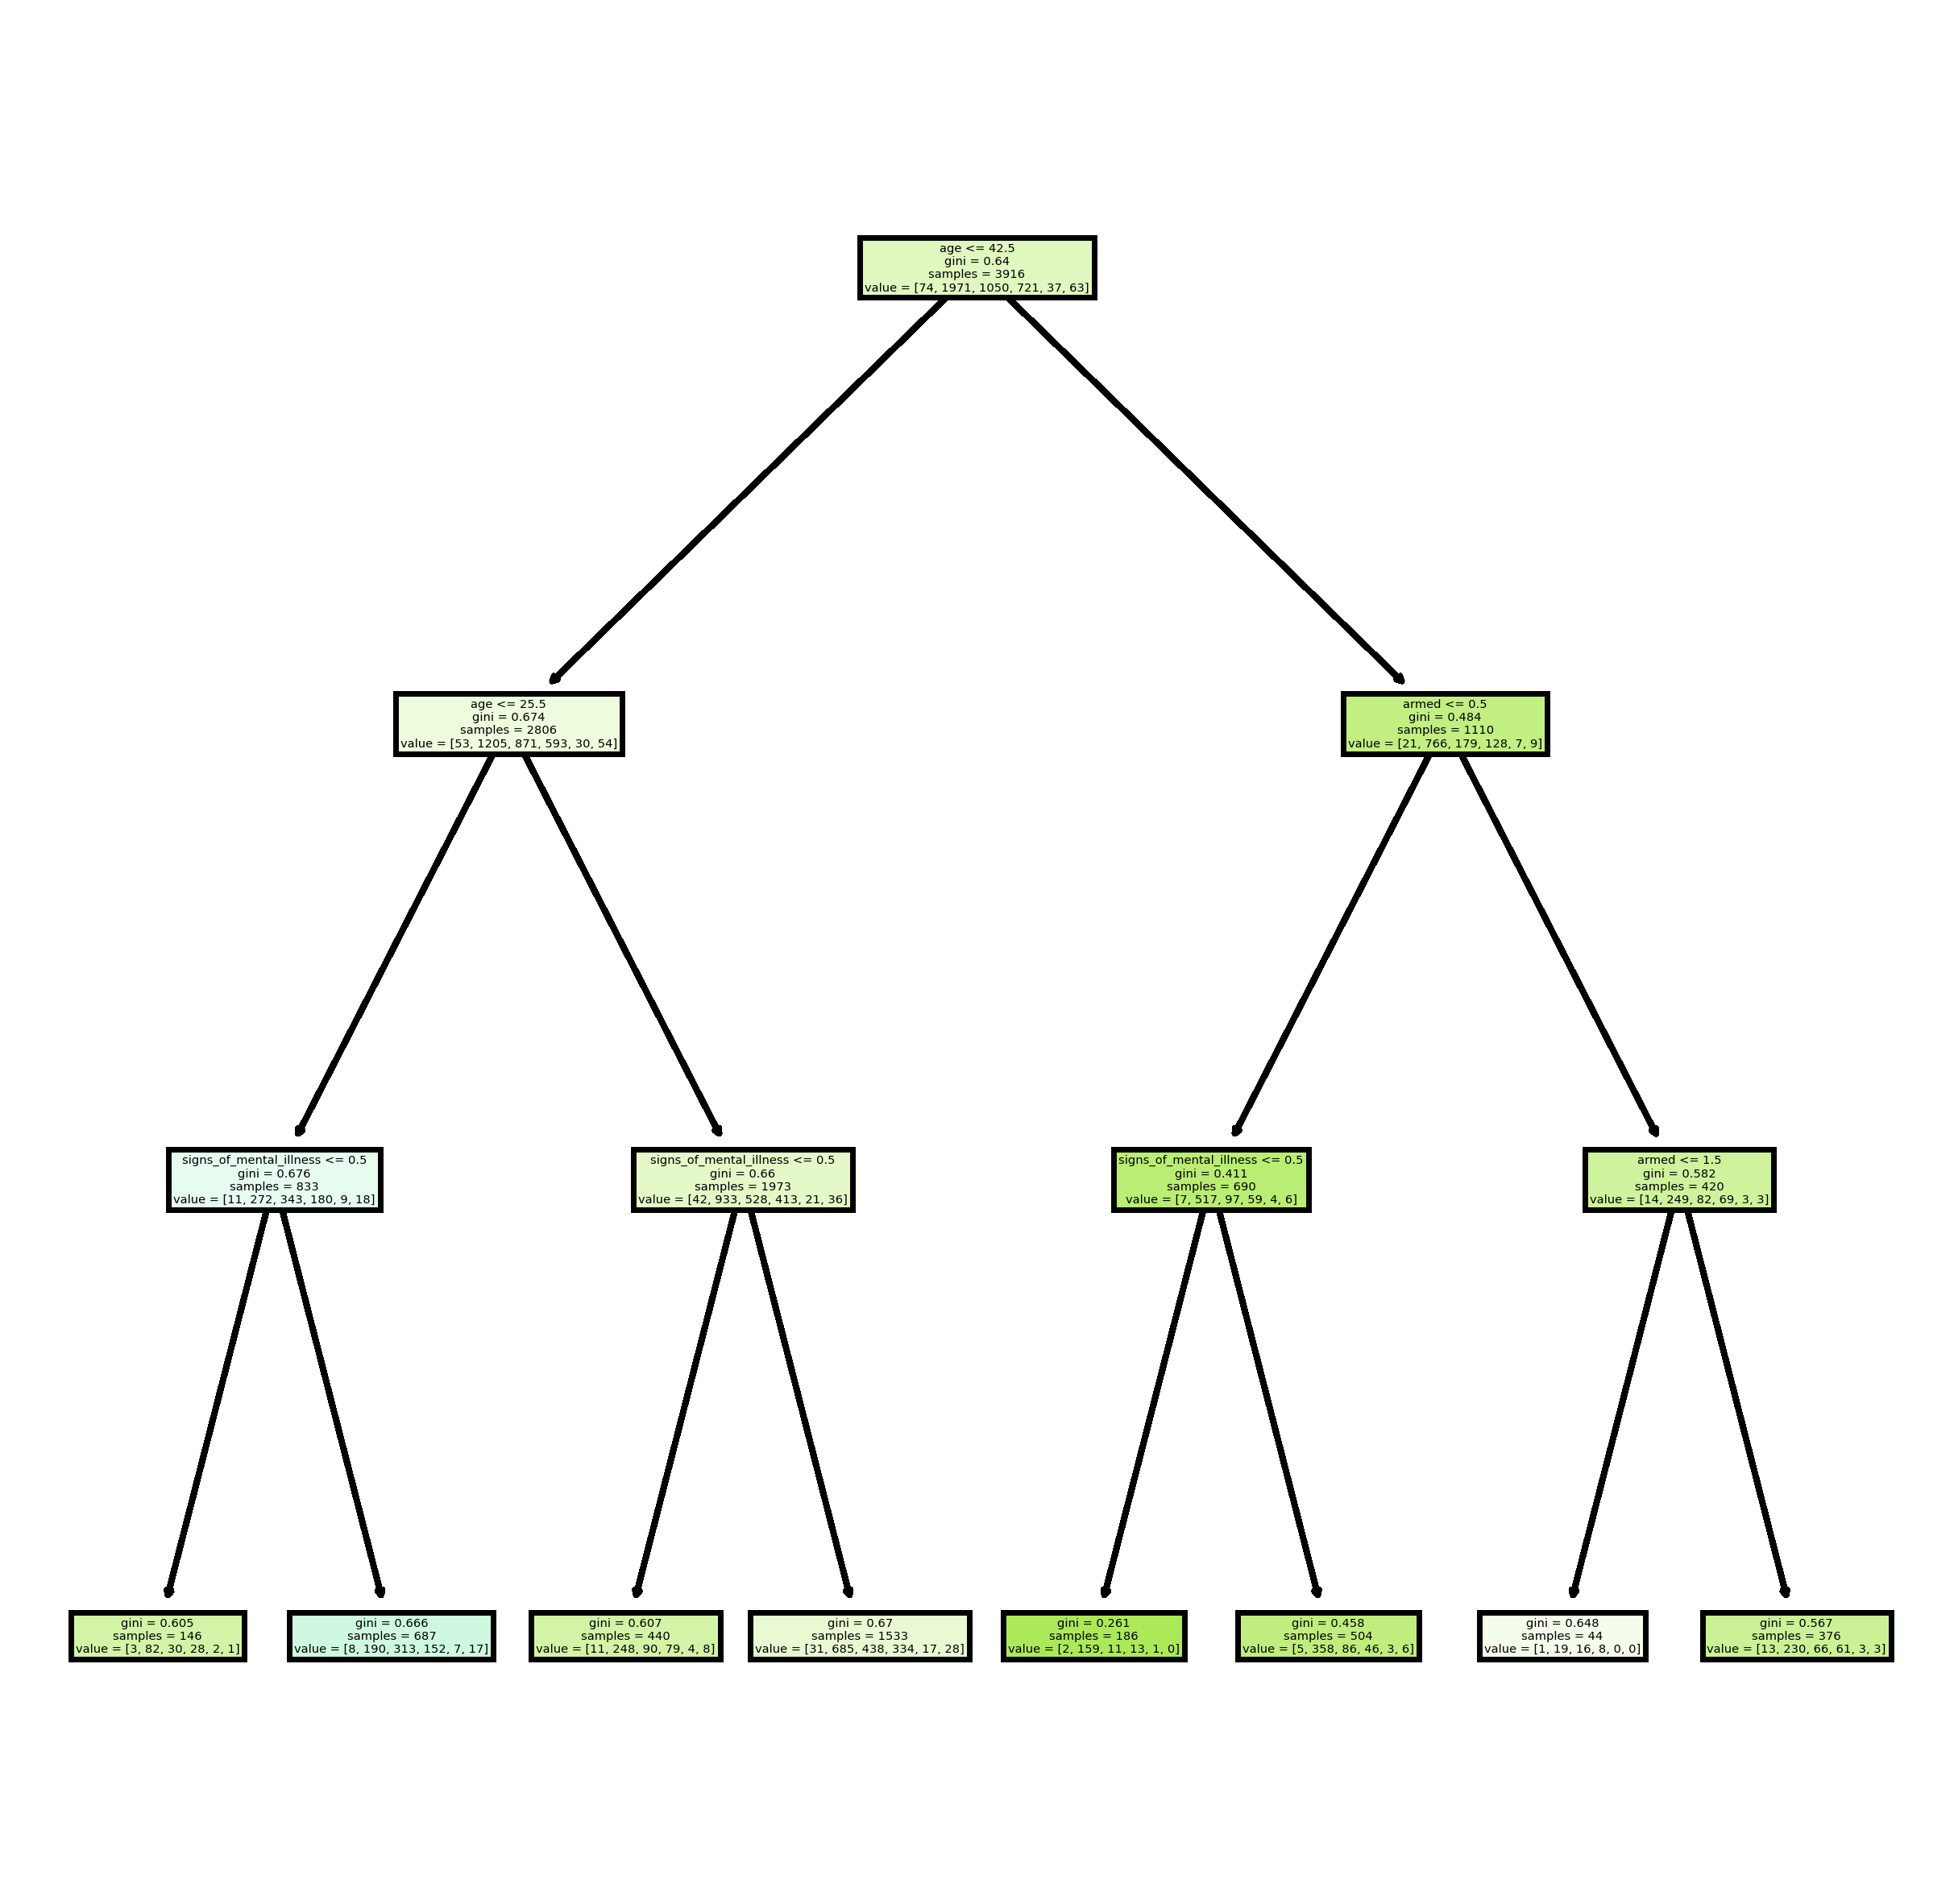
Model 3 Decision Tree

Slide 10
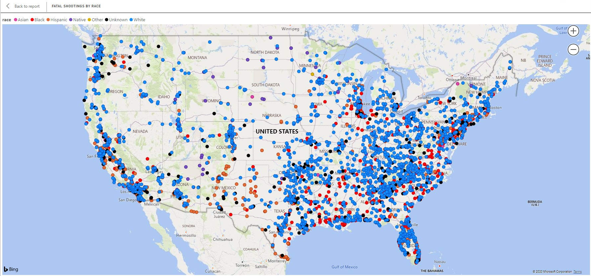
Fatal Shootings Map
Nationally white male are killed more often than any other group. However, when looking at large cities or metropolitan areas black males are killed at a higher rate.
Blue = White
Red = Black
Orange = Hispanic

Slide 11
Conclusion
Understanding how and why police shootings happen is a very difficult task. There are many different factors that can contribute to the situation. Making it a very complex issue to predict with certainty. However, this project was able to garner some meaningful insights that would be applicable for future analysis models, but more research is needed if the issues are to be addressed.

